Slide 1


Child Welfare & Attendance
Informational Guide for Parents

Slide 2

A Video on
Bringing Attendance Home

Slide 3

DID YOU KNOW??
Attendance is an important life skill that will help your child graduate from college and keep a job.
School is your child’s job. Their salary is the grade they receive.
Remember getting your child to school on time, everyday, unless they are sick, is your responsibility. While others can help, you are the bottom line.

Slide 4
What is an allowable absence?
Absences may be excused for the following reasons:
Personal Illness
Medical or dental appointment
Funeral for immediate family member (one day if service is in California, three days if service is out of state)
Jury duty (for students aged 18 or older)
Participation in religious instruction or exercises
Medical appointments for children of custodial teen parents
Ed. Code 46012, 5CCR 306 states absence verification must be submitted to the designated school site official within five school days from the last day of absence…

Slide 5
What is an allowable absence?
An absence may be justified for the following reasons:
Appearance in court
Attendance at a funeral service
Observation of a holiday or ceremony of his/her religion
Attendance at a religious retreat but no more than four hours during the semester
Employment interview or conference
.
Family vacations are never considered
excused or justified absences.

Slide 6
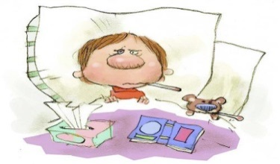
When is your child too sick to go to school?
If your child is…
Running a fever of 100 degrees or more, vomiting, diarrhea, uncontrollable cough, pinkeye, first day of a cold, or having flu like symptoms. Keep your child home and call the office to let them know he/she is sick for the day.
The school cannot assume that your child is out ill, call for everyday your child is out.
Know that mild sniffles, mild sore throat, or runny nose are not necessarily signs that your child needs to stay home from school.
*If your child needs medication, they do not have to miss school with a permission to dispense medication at school form.
District policy requires medical verification for excessive (more than 14) excused absences. Contact your school nurse for more information. Without doctor verification, the 15th and succeeding absences will be unexcused.

Slide 7

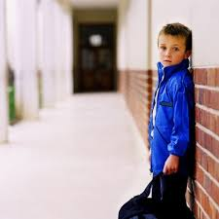
School Refusal
Absences can be a sign that a student is losing interest in school, struggling with school work, dealing with a bully or facing some other potentially serious difficulty.
If your child…
Always has a headache or stomach ache on Monday morning or the day of benchmark or other important testing
Becomes too ill at school to stay there and calls you to pick them up on a regular basis and the doctor cannot find a medical reason
Becomes withdrawn & reluctant to talk about the school day
Exhibiting any of the above may be flags for school refusal.
If your child is showing signs of “school refusal.”
Contact the school administrator and/or counselor for assistance.

Slide 8
What does the law say?
California Education Code section 48200 says, “each person between the ages of 6 and 18 years…..is subject to compulsory full-time education.
California Education Code section 48262 says, “any pupil is deemed a habitual truant who has been reported as a truant three or more times per school year…..”
City of Stockton Municipal Code 9.24.030 says, “…..it is unlawful and a misdemeanor for any minor under the age of 18 to remain in or upon any public street, sidewalk, park, or other public place within the city during curfew hours (11pm-6am/school hours) unless…..accompanied by a parent or guardian or other adult.”
California Education Code section 482620.5 states “…that the school district must notify the parent or guardian of the truant by the most cost-effective method possible, and that the notification must include specific information related to the student's unexcused absences.”
We notify at 3, 6 & 9 unexcused absences, tardies of 30 minutes or more and/or a combination of both.

Slide 9

What is one key idea that you will take away with you and share with another parent?

